Slide 1

REVIEW -2
TOURISM ANALYTICS
Using Descriptive and Predictive Data Mining Technologies
Batch-4
SECTION-7
G.HASINI-2420030421
G.KEERTANA-2420090075
S.RISHITHA-2420090060

Slide 2
Abstract & Objectives
A data-driven framework for understanding and forecasting tourism activity
Tourism analytics combines historical, behavioral, geographic and contextual data to support destination decisions.
Descriptive mining explains what happened through trends, distributions, seasonality and visitor segments.
Predictive mining estimates future arrivals, demand, revenue or crowd levels using statistical and machine-learning models.
The proposed system connects data ingestion, preprocessing, analytics, forecasting and dashboard-based decision support.
Objectives
• Identify high-demand periods and destination patterns.
• Forecast tourist arrivals using historical and external variables.
• Compare baseline and machine-learning models.
• Present interpretable insights through charts, KPIs and alerts.
• Support resource planning, marketing and crowd management.
Tourism Analytics | 2

Slide 3
Problem Statement & Analytics Scope
Problem Statement
Scope of Analysis
Tourist demand is seasonal, nonlinear and sensitive to weather, holidays, events, prices and disruptions.
Raw tourism data is often distributed across booking systems, government portals, reviews and search trends.
Decision-makers need both historical explanations and forward-looking estimates.
A unified analytics pipeline reduces manual analysis and improves consistency.
Inputs: arrivals, bookings, occupancy, weather, holidays, events, reviews and search interest.
Descriptive outputs: KPIs, trends, seasonality, visitor segments and destination comparisons.
Predictive outputs: next-period arrivals, demand category and anomaly warnings.
Users: tourism boards, hotels, transport providers, local authorities and researchers.
Tourism Analytics | 3

Slide 4
Methodology
1. Data Collection
2. Data Preparation
3. Feature Engineering
APIs, CSV files, open data, reviews
Cleaning, missing values, encoding
Lag, rolling mean, seasonality, events
4. Descriptive Mining
5. Predictive Mining
6. Evaluation
KPIs, clustering, correlation
ARIMA, Random Forest, XGBoost
MAE, RMSE, MAPE, R²
Tourism Analytics | 4

Slide 5
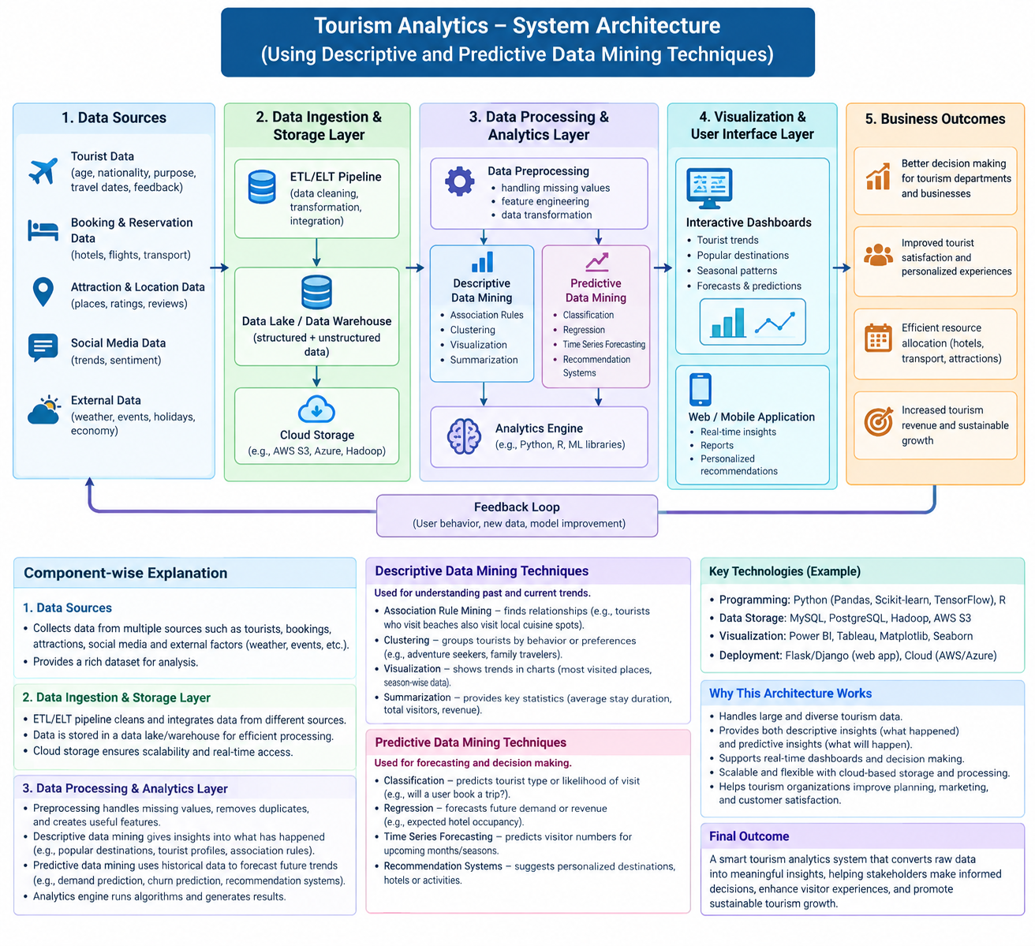
System Design / Architecture
Tourism Analytics | 5

Slide 6
Modern Tools & Technologies
Python
Forecasting
Visualization
pandas, NumPy, scikit-learn
statsmodels, Prophet, XGBoost
Plotly, Matplotlib, Power BI
Backend
Storage
Deployment
FastAPI / Flask, REST APIs
PostgreSQL / MySQL / cloud storage
Docker, Git, CI/CD, cloud VM
Tourism Analytics | 8

Slide 7
Implementation
Step 1: Import and merge destination-level datasets.
Step 2: Handle missing values, duplicates, outliers and inconsistent categories.
Step 3: Create temporal features such as lag-1, lag-7, lag-12 and rolling mean.
Step 4: Train models using chronological train/test splits.
Step 5: Store predictions and evaluation metrics.
Step 6: Display insights in an interactive dashboard with country/destination filters.
# Example feature engineering
df["date"] = pd.to_datetime(df["date"])
df = df.sort_values("date")
df["lag_1"] = df["arrivals"].shift(1)
df["rolling_7"] = df["arrivals"].rolling(7).mean()
df["month"] = df["date"].dt.month
df = df.dropna()
Implementation principle: reproducible notebooks + version-controlled scripts + saved model artifacts.
Tourism Analytics | 9

Slide 8
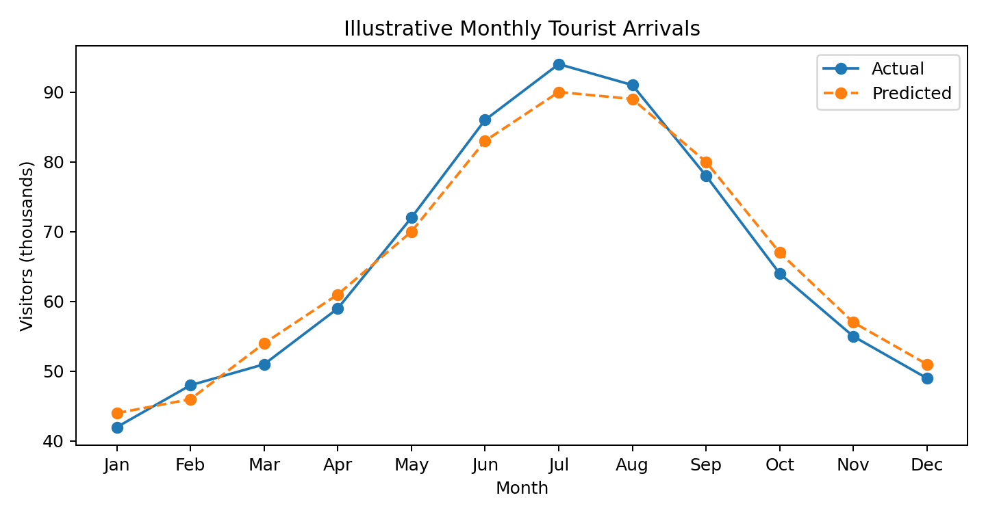
Results
The forecast follows the broad seasonal pattern in the illustrative series.
Small deviations appear around peak months, showing where additional features may help.
Dashboard users can compare actual versus predicted arrivals by country or destination.
Results shown here are demonstration values, not measured project outcomes.
Recommended output: forecast table + trend chart + alert when predicted capacity exceeds a threshold.
Tourism Analytics | 10

Slide 9
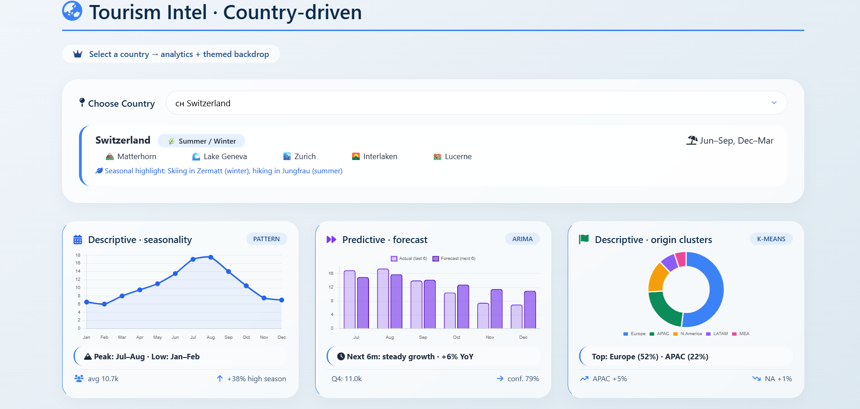

Slide 10
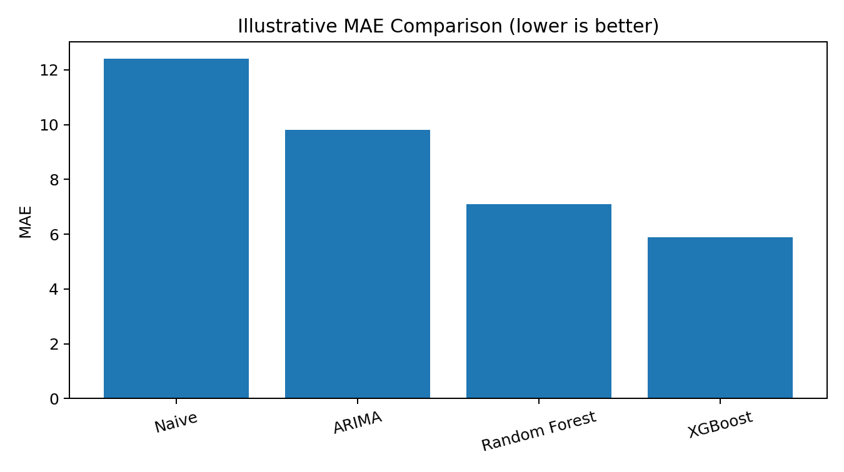
Performance Evaluation
MAE: average absolute prediction error; easy to interpret.
RMSE: penalizes large errors more strongly.
MAPE: percentage-based error; problematic when actual values are near zero.
R²: proportion of variance explained; use with error metrics.
Evaluate against a naïve baseline and use chronological cross-validation.
Illustrative model comparison — actual values should be calculated from the final dataset.
Tourism Analytics | 11

Slide 11
Research Paper Evaluation
Study / Approach
Data & Method
Relevant Contribution
Limitation / Gap
Xu et al. (2023)
Daily demand; attention-based encoder–decoder
Uses temporal heterogeneity and interpretability
Higher complexity; destination-specific validation
Fu & Qin (2026)
Weekly arrivals; VMD/EWT + XGBoost
Leakage-free denoise–decompose–learn framework
Requires careful tuning and preprocessing
Tourism Forecasting (2026)
Multi-period spatiotemporal deep learning
Models spatial and temporal dependencies
Needs richer multi-destination data
Post-pandemic RNN (2026)
20 destinations; ensemble RNN
Integrates external variables and destination relations
Generalization depends on changing conditions
Synthesis: recent research increasingly combines multi-source data, hybrid models and interpretability.
Tourism Analytics | 12

Slide 12
Conclusion & Future Scope
Descriptive mining explains tourism behavior using trends, segmentation and anomaly analysis.
Predictive mining supports proactive planning by estimating future demand.
A layered architecture improves maintainability, scalability and integration with dashboards.
Model evaluation must consider accuracy, interpretability, data leakage and operational usefulness.
Future Scope
• Real-time streaming from IoT counters and booking feeds.
• Multimodal sentiment analysis from reviews and social media.
• Explainable and uncertainty-aware forecasting.
• Geospatial heat maps for crowd and mobility management.
• Model monitoring and automatic retraining.
Tourism Analytics | 13

